Slide 1
Sprint 1 - Part 2
Easter Egg

Slide 2
Timeline
Wednesday (2/25):
Discussed architecture and task-progress
Friday (2/27)
Began Demo planning
Sunday Meeting:
Discussed Progress (completed / left)
Compilation Issues
Integration
Today:
Code-Review process
Completed Demo Planning
Notes:
… the progress of our self-assigned tasks
What’s done and what’s left before the demo

Slide 3
State of the Project
Current State:
Pivoted to Sports Team Tracking
Frontend / Backend Integration
DB Setup
Docker Environment
Frontend / Backend Communicate Mock Data
Completed User Stories Planned for Sprint 1 / Demo

Slide 4
Metrics
Metrics:
SP Self-Assigned, Velocity Tracking
Completed Our User Stories
SPI / Pipeline Status?
Rough Plan for Following Week
More User Stories, Such As…
Moving Beyond Mock Data with DB Querying
Continue Developing/Expanding Functionality and UX
Notes:
Not tracking velocity … only just given time to put a chart together in today’s class

Slide 5
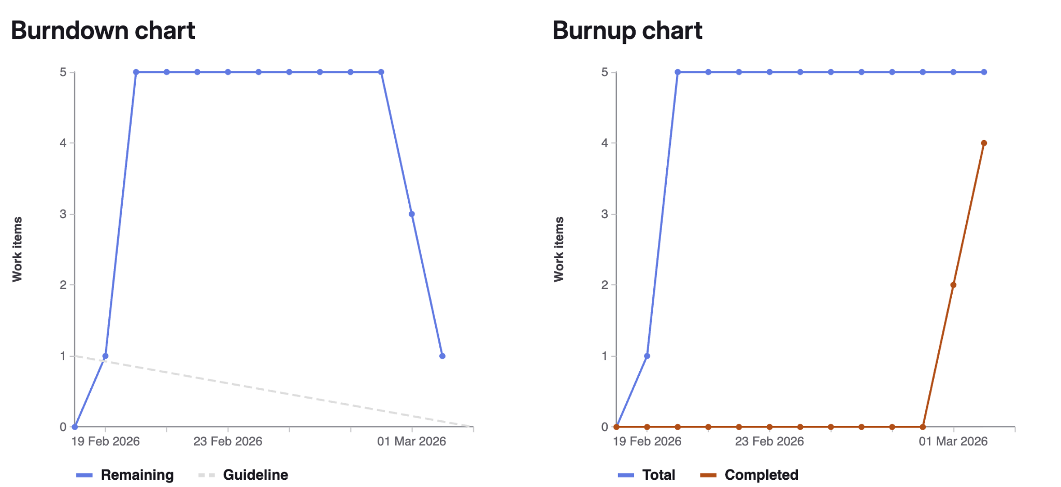

Slide 6
Issue # | User Story / Task Description | Assigned To | Status Completed/ Incompleted | Story Points | Technical Validation (The "Demo" Proof)
#22 | FlightList Components, Service Calls | Corey | Completed
#49 | Implement Backend Endpoints | Ernesto Akhil | Completed | 6 | Mock Data Responses to Frontend
#42 | API | Jack | completed | 5 | Run api script and show json files
#26 | Docker Compose | Yazod | completed
#25 | DB Schema | Alan | Completed
#48 | Frontend Backend Integration | Akhil | Completed | 6 | FrontEnd Tracking page getting data from backend
Notes:
Not very interesting

